Slide 1
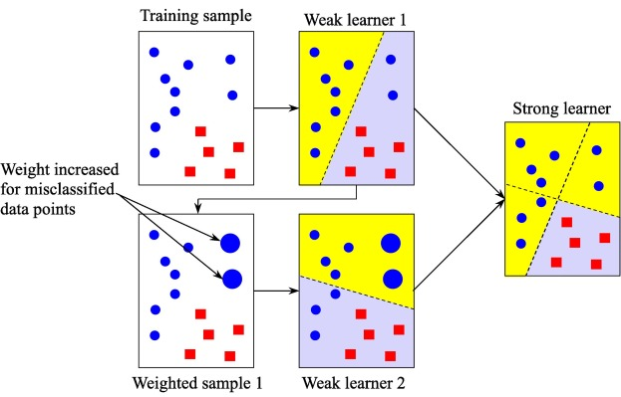
LGBoost
The light gradient boosting machine regressor (LightGBM) is a breakthrough tree-based ensemble learning approach developed by researchers at Microsoft and Peking University to overcome the efficiency and scalability difficulties of XGBoost in high-dimensional input feature.

Slide 2
Key features of LGBoost
Light GBM is designed to handle large-scale datasets efficiently.
Speed: Light GBM is faster than other popular gradient-boosting frameworks like XGBoost and CatBoost. This is because it uses a gradient-based one-sided sampling method to split trees, which reduces memory usage and improves accuracy.
Scalability: Light GBM can handle large-scale datasets with millions or billions of records and thousands of features. It can also handle various data types, including categorical, numerical, and text.
Accuracy: Light GBM is known for its high accuracy and ability to handle imbalanced datasets. It achieves this by using a variety of techniques, such as gradient-based one-sided sampling, regularization, and data balancing.
Flexibility: Light GBM offers a wide range of options for model customization and optimization. It includes built-in features for data preprocessing, cross-validation, and hyperparameter tuning, making it easier for users to optimize their models.

Slide 3
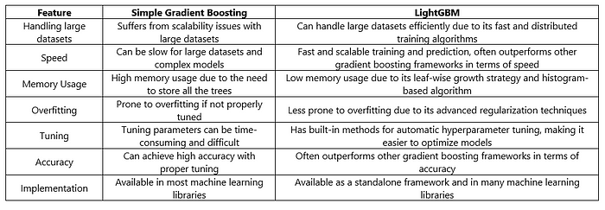
LGBoosting Vs Simple Gradient Boosting

Slide 4
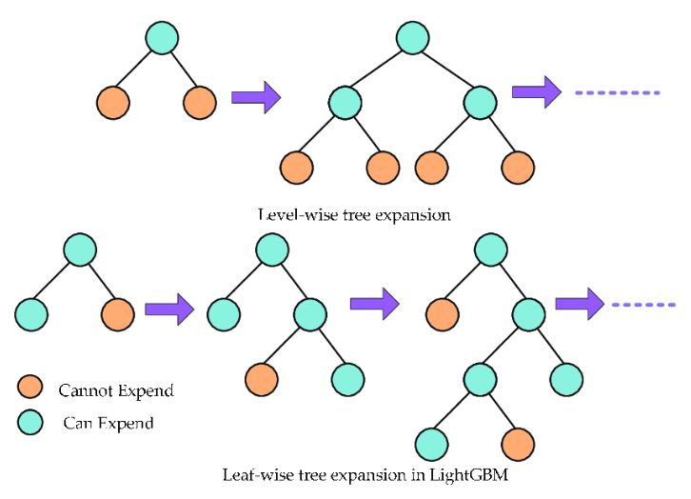
LGBoost

Slide 5
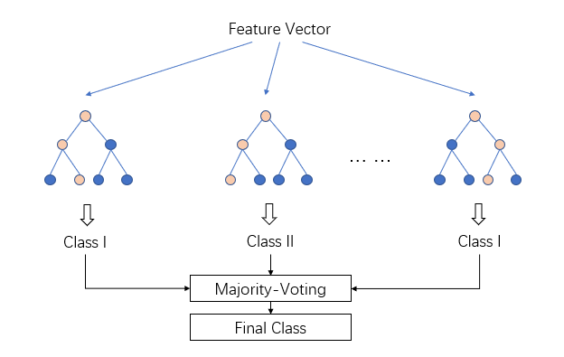
LGBoost

